Slide 1
Assignment 4 Briefing
Dr. Tan Chee Keong
School of Information Technology

Slide 2

PART 1 - Analyze a cybersecurity vulnerability or incident (upload 1 pdf file with the report to Moodle)

Slide 3
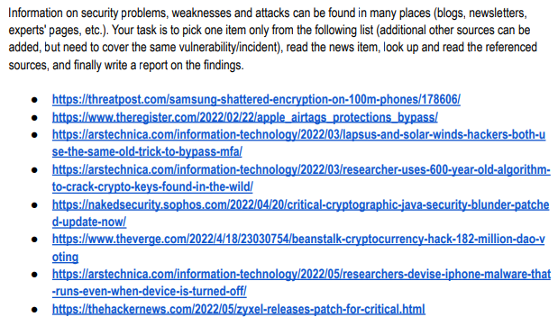

Slide 4
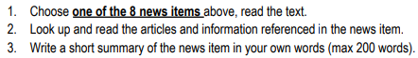
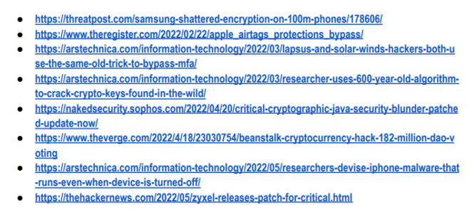

Slide 5
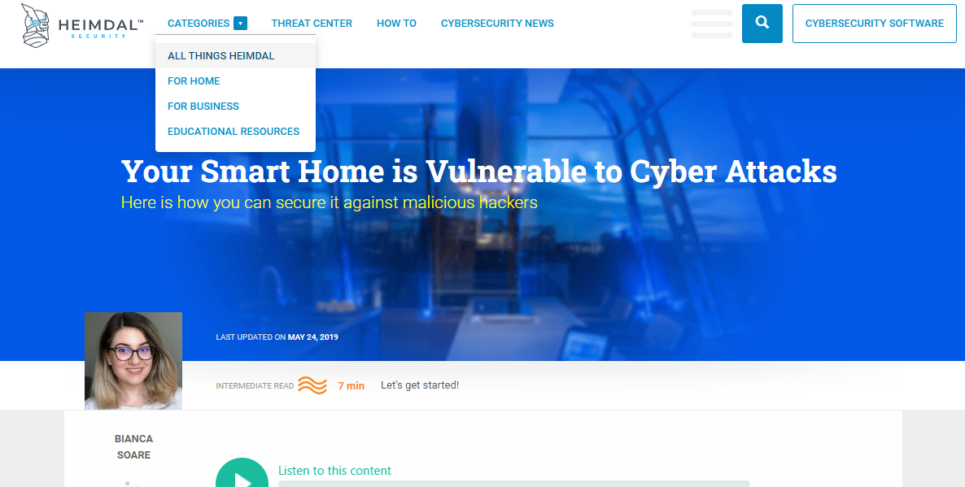

Slide 6
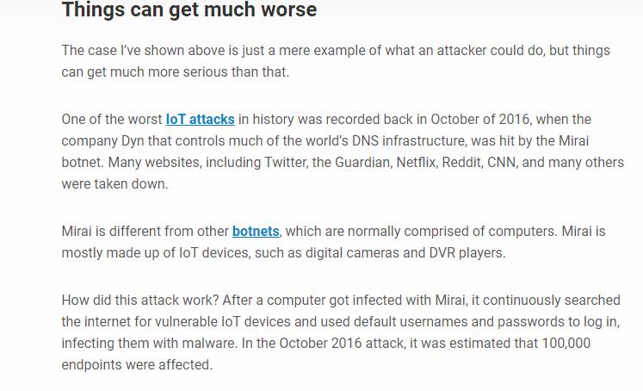
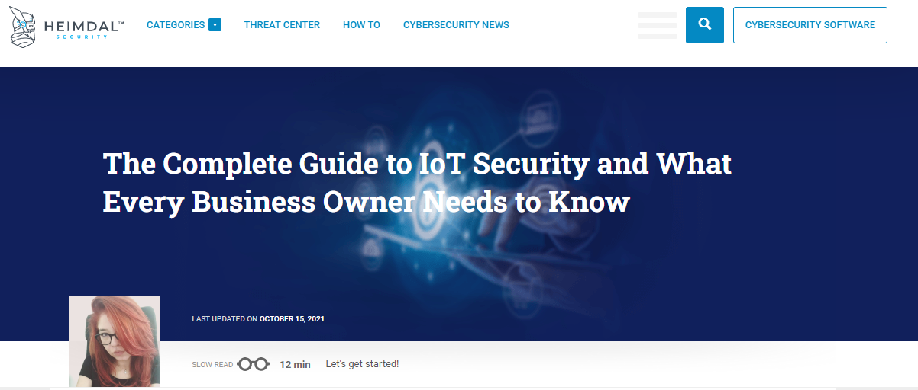
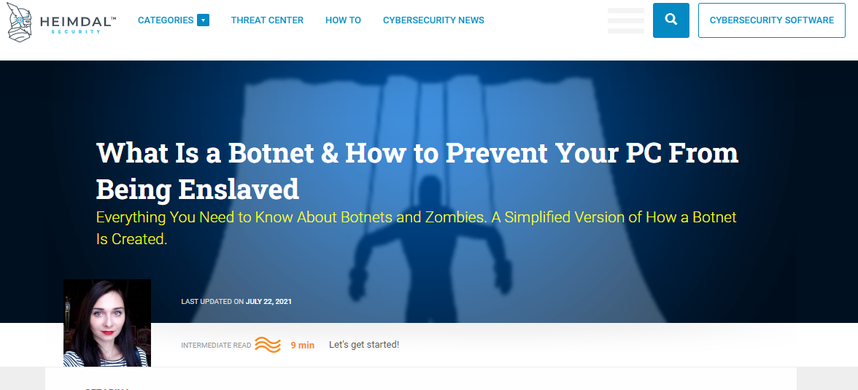
Reference
Reference

Slide 7
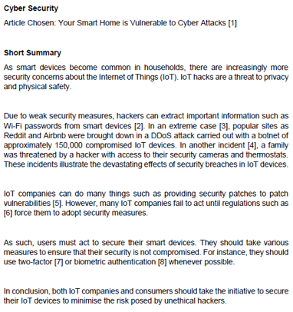
Briefly describe the attack (type of attacks, attacks on what, the consequences of attacks)
Why and how the attack can happen? Examples? Case studies?
What actions have been taken against the attacks? Examples? Whose responsibilities against the attack?
Concluding remarks.

Slide 8


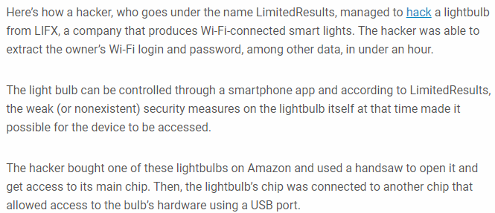

Slide 9
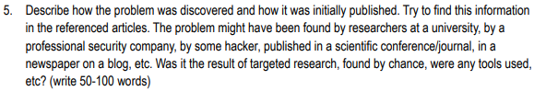
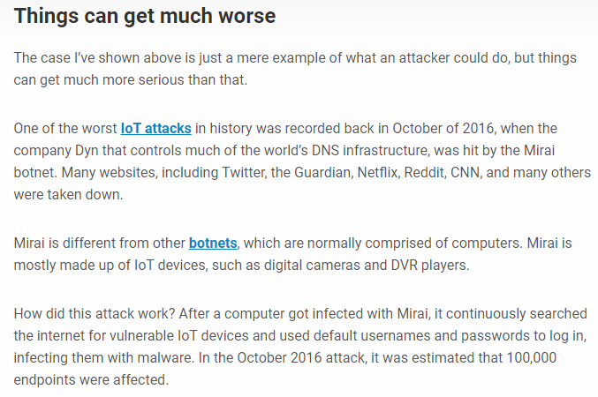

Slide 10
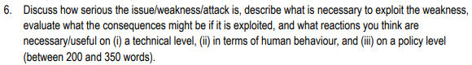
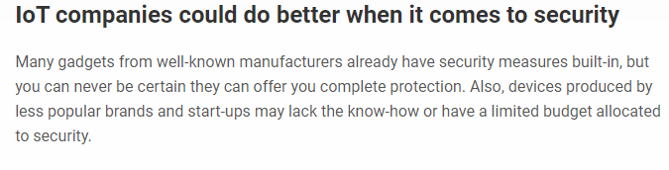
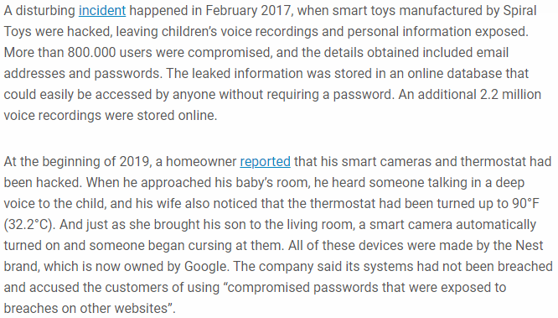
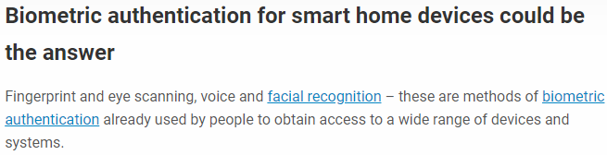

Slide 11
Part 2 - Security controls in a medium sized company scenario (upload 1 pdf file with the slides and 1
video with your presentation to Moodle)

Slide 12

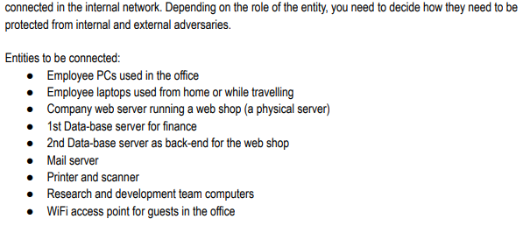
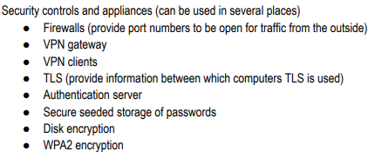

Slide 13
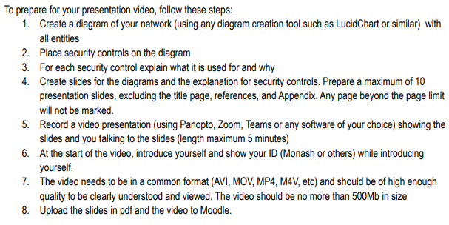
Security Architect
Ensures that the stakeholder security requirements necessary to protect the organization’s mission and business processes are adequately addressed in all aspects of enterprise architecture including reference models, segment and solution architectures, and the resulting systems supporting those missions and business processes.

Slide 14
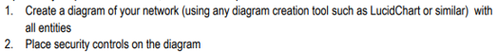
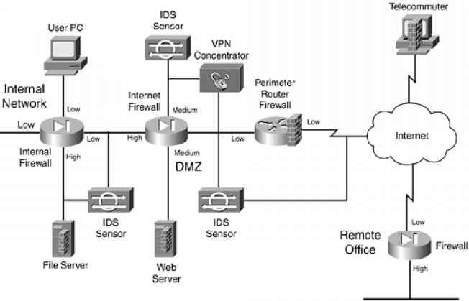

Slide 15
Why you need VPN here?
What is the purpose of having router firewall?
Why DMZ is required in this organization?
Do you need TLS, HTTPS?
Is your file secure here? How you store your password?

Slide 16




Slide 17
